Slide 1

Teacher To-Do Mini Intro
Presented By: Sam Gerstner, Alexander Fornette, Noah Nannen, Shlok Sheth & Bronwyn Wedig

Slide 2

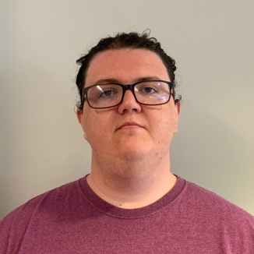

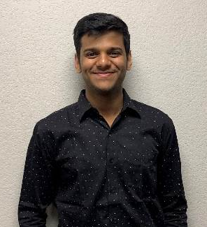
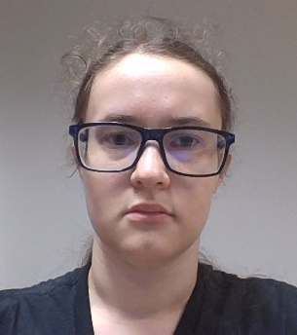
Team Introduction
Sam Gerstner
Team Lead
Alexander Frenette
Backend Developer
Noah Nannen
User Interface Developer
Shlok Sheth
Full Stack Developer
Bronwyn Wedig
Front End Manager
Chris Aungst
Project Sponsor
Italo Santos
Faculty Mentor

Slide 3
Introduction
The education of children is critical to the future success of our entire society. In Arizona alone, there are an estimated 2,600 teaching positions that remain open this school year. In order to help fill this gap and ensure the success of Arizona students, the Arizona Department of Education has started a new program that allows undergraduate education students the opportunity to fill some of these vacant positions and gain hands on experience in the classroom while finishing their degree.
The College of Education is tasked with assisting NAU students who would like to enter these vacant positions. This involves ensuring that students meet a variety of requirements set out by AZDE, gathering supporting documentation and ensuring that each student has the support they need to be successful.

Slide 4

Our Client
Christopher Aungst , Director of College of Education
STIC program has been launched so that students can intern as a teacher
Although there are a lot of criteria a student must satisfy in order to be eligible for the program
Keeping track of the requirements for STIC program for individual student is a difficult task, takes almost 500 mans hours to manually do it
There are a lot of accountable people involved in the process
The current process is Tiresome, Time Consuming & Inefficient

Slide 5
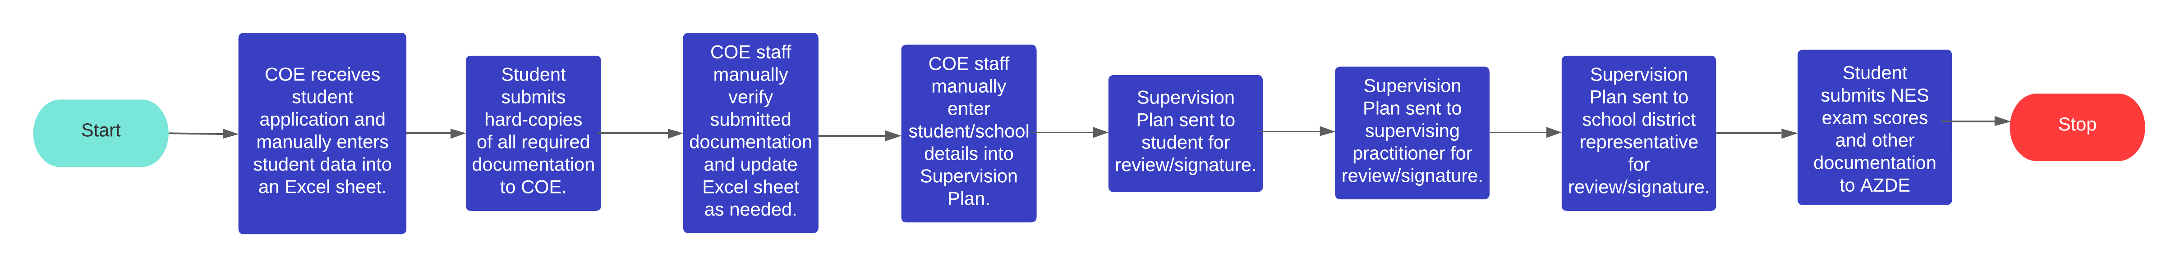
Current Solution Overview/Problems
COE staff currently use a manual process to track requirements for each individual student teacher in an Excel spreadsheet.
The STIC program is available to 12 different degree programs each with different requirements that must be managed.
COE staff spend over 500 hours each semester on this process that could be used to provide other services to COE students.
Accuracy and completeness are key aspects of this process because we must represent the University in a positive light.

Slide 6
Ideal Solution
A web app that will act as a single source of truth for all student information. Storing school records along with auxiliary documents.
This information will be pulled from existing school records API’s.
Student and admin accounts and authentication will be provided through CAS.
Ability to send documents for signatures electronically.

Slide 7
Nonoptimal Solution
If access to existing school infrastructure is denied we still have options.
The system will continue to offer the same functionality, but will require additional human input.
Student records will be imported by a college employee and site admin. It will then be parsed by the system to generate student accounts, and accompanying data.

Slide 8
Plan for Development
We plan to have bi-weekly meetings with our client to have high-level discussions or requirements and obtain feedback on design choices.
We will adopt an Agile approach due to the need to adapt to inevitable requirement changes. A Kanban board is used to track progress and assign tasks.
We have already begun our technical investigation and have started acquiring some resources that may take longer to obtain like CAS integration.
Because we are handling student records, we must take student privacy into account to ensure data integrity.

Slide 9
Challenges
Acquisition of reliable data in an automated way.
Assume we have access, or create a system for importing of data for the admins?
Loose coupling of front end to backend. API
Our data model is subject to change, and still not fully known due to lack of access to school systems. Assuming we get access to school data, what happens if their return format changes?
Security and confidentiality of student data.
As we are working with sensitive data that is protected by federal law, we need to take care to secure access. What are the required safeguards?

Slide 10
Challenges cont.
Choosing tools
First we look if members have familiarity or preference, and discuss reasons for use. If none exist, we explore 3 options and chose best fit. Our influences are industry adoption, ease of use, and cost.

Slide 11
Conclusion
Our system will make it easier for students and faculty to track the many required documents for the STIC program. This reduces time an overseer spends checking that each individual student has all their documents, and simplifies the process for students who can clearly see what remains in their application.
Document management systems similar to this could be used in many sorts of application tracking situations.

